Slide 1
CMATCH APP
By
K.Harish (411465)
Mrunalini (412091 )
Vinay Nukala(411222)

Slide 2






TECHNOLOGIES USED

Slide 3

MODULES DISTRIBUTION
HARISH
Log In
Favourites
MRUNALINI
Registration
Image
VINAY
Updates
Getting Data from 3rd party API
UI

Slide 4

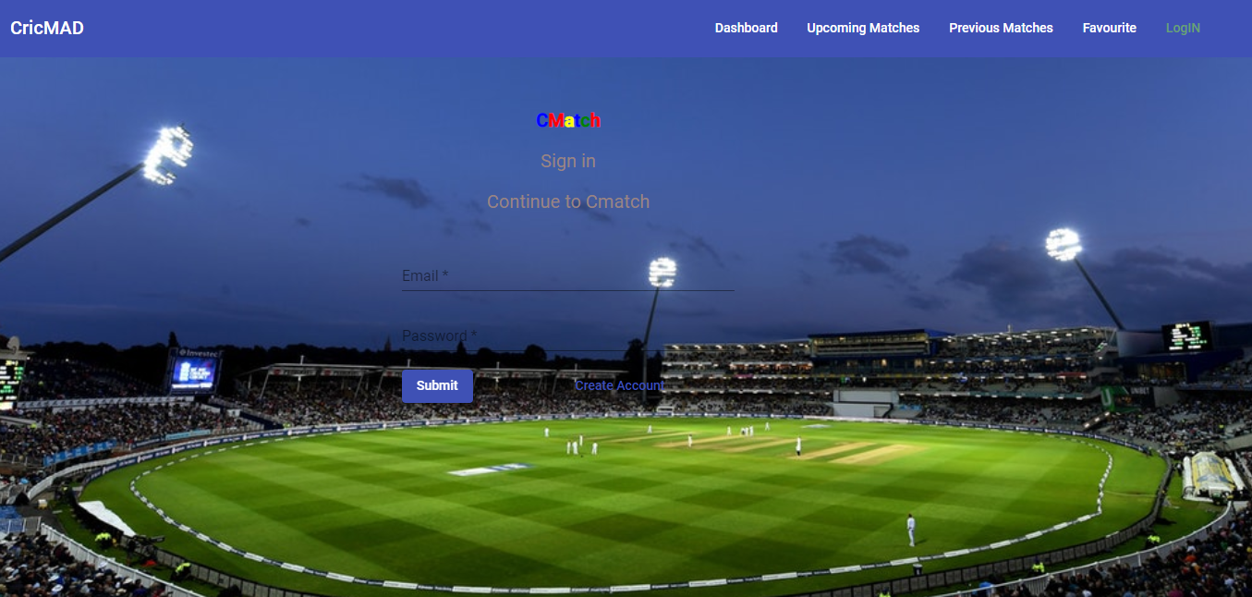
LOGIN COMPONENT

Slide 5
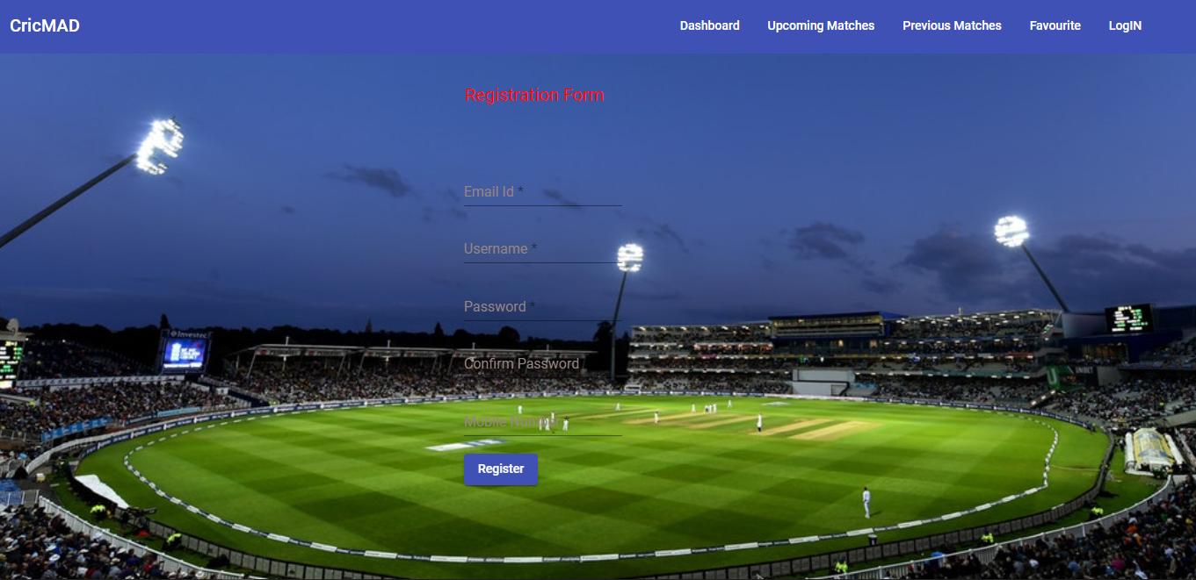
REGISTRATION COMPONENT

Slide 6
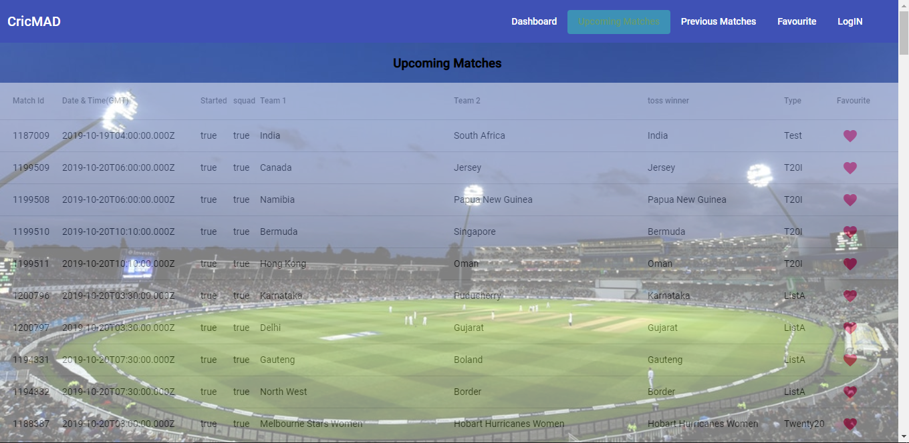
UPCOMING MATCHES

Slide 7
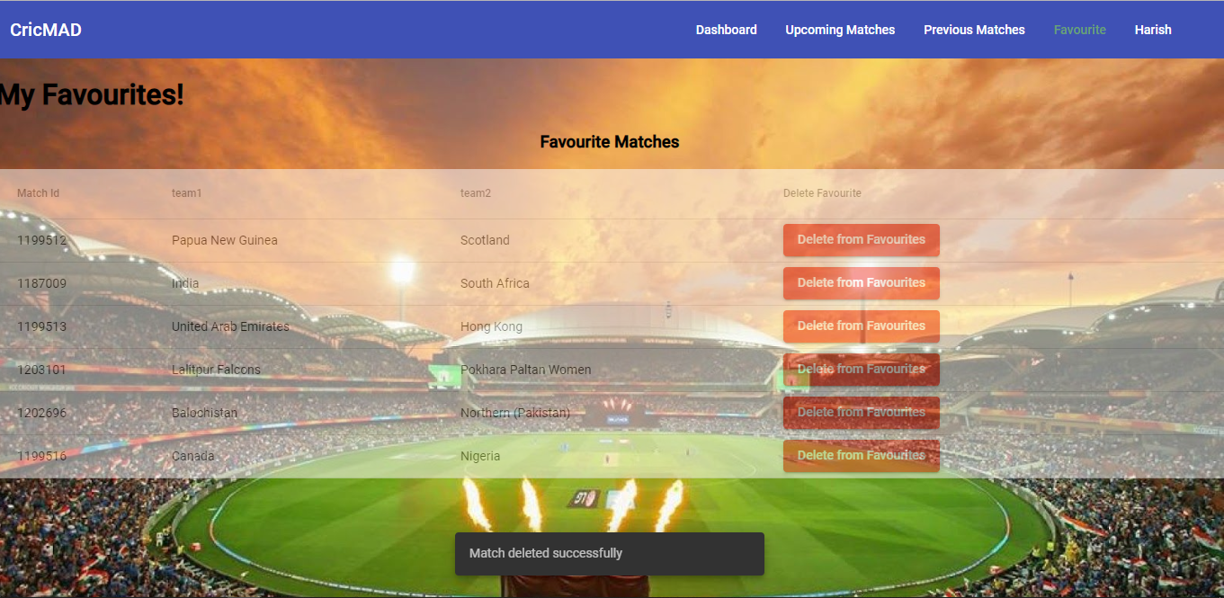
FAVOURITES

Slide 8
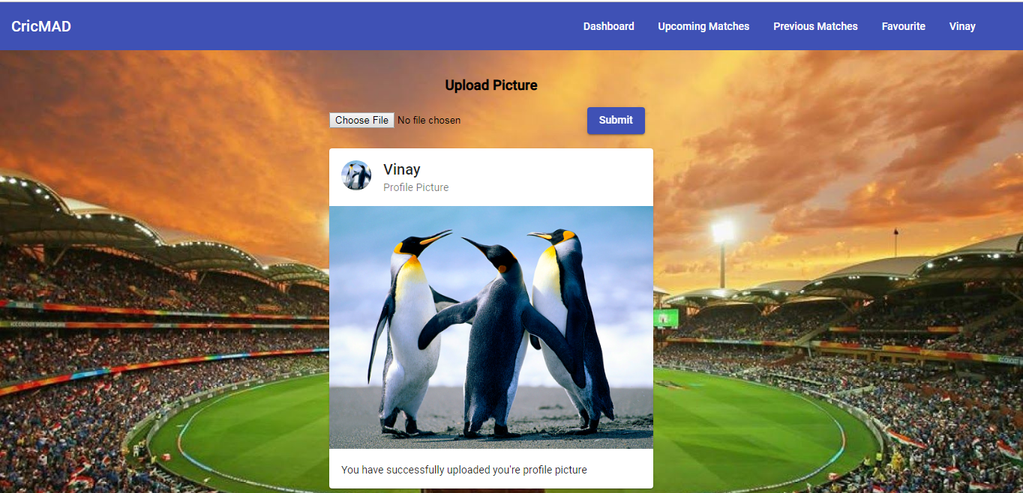
UPLOAD IMAGE

Slide 9
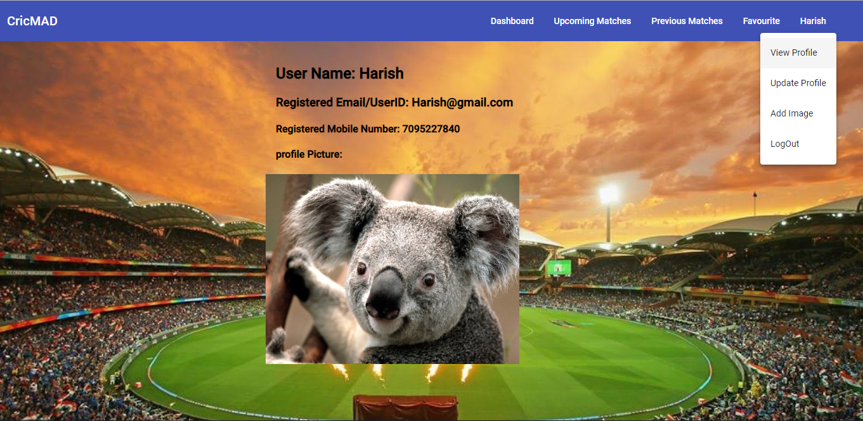
VIEW PROFILE

Slide 10
PROBLEM STATEMENTS
Unable send token from front end to back end.
User needs to refresh page to get their name on header bar.
Image uploading could be done better.
In Update Profile Some betterments where requried

Slide 11
FURTHER ENHANCEMENT
Can store more user details like DoB, etc.
Can get detailed score from every match.
Can suggest recommend matches based on his/her favourite matches
Forget Password and User Friendly Ui

Slide 12
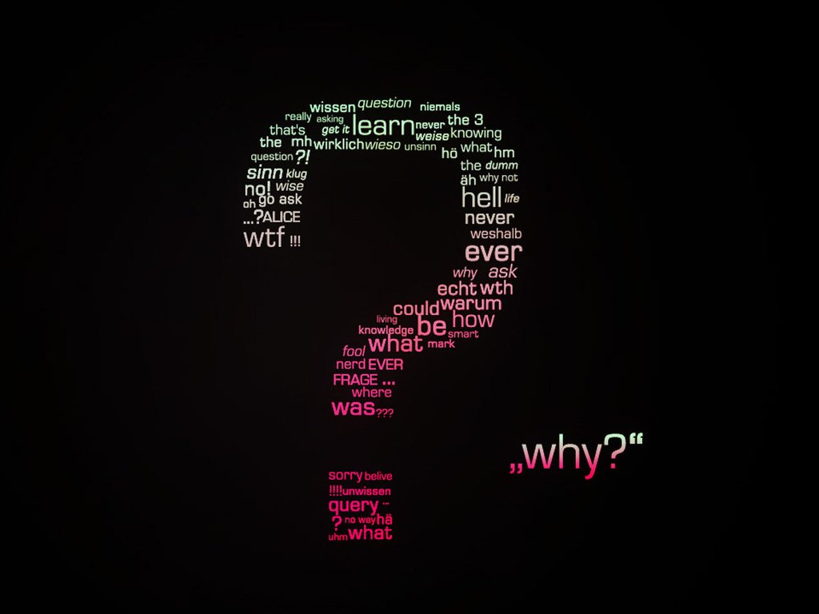
Any Question

Slide 13


